Slide 1


Pharmacy First Pack for Receptionists and Care Navigators
H&NY V1 – 29th Feb 24

Slide 2

The Pharmacy Elements of Primary Care Access and Recovery Plan (PCARP)
On 9th May 2023, NHS England and Department of Health and Social care published the Delivery Plan for recovering access to primary care.
The community pharmacy elements of the plan are:
  A Pharmacy First service which includes GP referral to Community Pharmacist Consultation Service (CPCS) and 7 new clinical pathways
  Increase the provision of the NHS Pharmacy Contraception Service and the NHS Blood Pressure Checks Service.
  Improve the digital infrastructure between general practice and community pharmacy.
  A letter to practices on 25 January confirms Pharmacy First starts on 31 January: NHS England » Launch of NHS Pharmacy First advanced service

Slide 3
NHS Pharmacy First
Pharmacy First will include 7 new clinical pathways. The Community Pharmacist Consultation Service (CPCS) becomes part of Pharmacy First too.
This means the full service will consist of three elements:
Pharmacy First (clinical pathways)
Pharmacy First (referrals for minor illness)
Pharmacy First (urgent repeat medicines supply)
NB Not from general practices but from NHS 111 and UEC settings
new element
previously commissioned as CPCS
previously commissioned as CPCS
Community pharmacy contractors must provide all 3 elements
The only exception is that Distance Selling Pharmacies (sometimes called internet or online pharmacies) will not do the otitis media pathway (because they can only do remote consultations so cannot use otoscopes)
General practices cannot refer patients to pharmacies for urgent medicines supply using Pharmacy First but should refer appropriate patients for the other two elements (clinical pathways and minor illness)

Slide 4
What are the 7 new clinical pathways that can be referred to Pharmacy First (Previously known as CPCS)?
Clinical Pathway | Age range
Uncomplicated UTI Shingles Impetigo Infected Insect Bites Sinusitis Sore Throat Acute Otitis Media | Women 16-64 years 18 years and over 1 year and over 1 year and over 12 years and over 5 years and over 1 to 17 years

Slide 5
NHS Pharmacy First – referrals for minor illnesses
Service suitability
The service is only for patients aged over 1 year.
Important:
Please note this slide is intended as a guide and has been adapted from a similar table used to support CPCS minor illness referrals from GP practices which now forms part of Pharmacy First along with the 7 Clinical Pathways.
Following referral for a minor illness the pharmacist will assess the patient and either
- support the patient through what was previously the minor illness pathway for CPCS,
- if necessary they will assess and check if the patient needs and can be supported through the 7 clinical pathways
- or if e.g. symptoms have deteriorated or red flags are identified, promptly escalate them to higher acuity support.
CONDITIONS | What conditions are SUITABLE for referral to pharmacists? |  |  | Do NOT refer in these circumstances
BITES / STINGS | Bee sting Wasp sting | Stings with minor redness | Stings with minor swelling | Drowsy / fever Fast heart rate | Severe swellings or cramps
COLDS | Cold sores Coughs | Flu-like symptoms | Sore throat | Lasted +3 weeks Shortness of breath | Chest pain Unable to swallow
CONGESTION | Blocked or runny nose | Constant need to clear their throat | Excess mucus Hay fever | Lasted +3 weeks Shortness of breath | 1 side obstruction Facial swelling
EAR | Earache | Ear wax Blocked ear | Hearing problems | Something may be in the ear canal Discharge | Severe pain. Deafness Vertigo
EYE | Conjunctivitis Dry/sore tired eyes Eye, red or Irritable | Eye, sticky Eyelid problems | Watery / runny eyes | Severe pain Pain 1 side only | Light sensitivity Reduced vision
GASTRIC / BOWEL | Constipation Diarrhoea Infant colic | Heartburn Indigestion | Haemorrhoids Rectal pain, Vomiting or nausea | Severe / on-going Lasted +6 weeks | Patient +55 years Blood / Weight loss
GENERAL | Hay fever | Sleep difficulties | Tiredness | Severe / on-going
GYNAE / THRUSH | Cystitis Vaginal discharge | Vaginal itch or soreness |  | Diabetic / Pregnant Under 16 / over 60 Unexplained bleeding | Pharmacy treatment not worked Had thrush 2x in last 6 months
PAIN | Acute pain Ankle or foot pain Headache Hip pain or swelling Knee or leg pain | Lower back pain Lower limb pain Migraine Shoulder pain | Sprains and strains Thigh or buttock pain Wrist, hand or finger pain | Condition described as severe or urgent Conditions have been on- going for +3 weeks | Chest pain / pain radiating into the shoulder Pharmacy treatment not worked Sudden onset
SKIN | Acne, spots and pimples Athlete's foot Blisters on foot Dermatitis / dry skin Hair loss | Hay fever Nappy rash Oral thrush Rash - allergy Ringworm/ threadworm | Scabies Skin dressings Skin rash Warts/verrucae Wound problems | Condition described as severe or urgent Conditions have been on- going for +3 weeks | Pharmacy treatment not worked Skin lesions / blisters with discharge Diabetes related?
MOUTH / THROAT | Cold sore blisters Flu-like symptoms Hoarseness | Mouth ulcers Sore mouth Sore throat | Oral thrush Teething Toothache | Lasted +10 days Swollen painful gums Sores inside mouth | Unable to swallow Patient has poor immune system Voice change
SWELLING | Ankle or foot swelling Lower limb swelling | Thigh or buttock swelling Toe pain or swelling | Wrist, hand or finger swelling | Condition described as severe or urgent Condition ongoing for +3 weeks | Discolouration to skin Pharmacy treatment not worked Recent travel abroad
Ver 1.6 NHS England, July 2019.

Slide 6
NHS Pharmacy First – 7 clinical pathways
Please note these are the main exclusions. Each pathway has additional specific clinical exclusions which will be considered by the community pharmacist during the consultation.
N.B. A link to the clinical pathways and the PGDs can be found here NHS England » Community Pharmacy advanced service specification: NHS Pharmacy First Service
Urinary tract infection | Shingles* | Impetigo | Infected insect bites | Acute sore throat | Acute sinusitis | Acute otitis media
A UTI is an infection in any part of the urinary system. | Shingles is an infection that causes a painful rash | Impetigo is a common infection of the skin. It is contagious, which means it can be passed on by touching. | Insect bites and stings can become infected or cause a reaction. | Sore throat is a symptom resulting from inflammation of the upper respiratory tract | Sinusitis is swelling of the sinuses, usually caused by an infection. The sinuses are small, empty spaces behind your cheekbones and forehead that connect to the inside of the nose. | An infection of the middle ear.
Inclusion: Female Aged between 16 - 64 Suspected lower UTI | Inclusion: 18 years and over Suspected case of shingles. Rash appeared within the last 72 hours - 7 days | Inclusion: 1 year and over Signs and symptoms of impetigo Localised (4 or fewer lesions/clusters present) | Inclusion: 1 year and over Infection that is present or worsening at least 48 hours after the initial bite(s) or sting(s) | Inclusion: 5 years and over Suspected sore throat | Inclusion: 12 years and over Suspected signs and symptoms of sinusitis Symptom duration of 10 days or more | Inclusion: Aged between 1 – 17 Suspected signs and symptoms of acute otitis media
Exclusion: Male <16 or >64 Pregnant Breastfeeding Recurrent UTI (2 in last 6 months or 3 in last 12 months) Catheter | Exclusion: < under age of 18 Pregnant or suspected pregnancy Breastfeeding with shingle sores on the breasts Shingles rash onset over 7 days ago | Exclusion: < under 1 year of age Pregnancy or suspected pregnancy in individuals under 16 years of age Breastfeeding with impetigo lesion(s) present on the breast Recurrent impetigo (2 or more episodes in the same year) Widespread lesions/ clusters present Systemically unwell | Exclusion: < under 1 year of age Pregnancy or suspected pregnancy in individuals under 16 years of age Systemically unwell Bite or sting occurred while travelling outside the UK | Exclusion: Individuals under 5 years of age Pregnancy or suspected pregnancy in individuals under 16 years of age Recurrent sore throat/tonsillitis (7 or more significant episodes in the preceding 12 months or 5+ in each of the preceding 2 years, or 3+ in the preceding three years) Previous tonsillectomy | Exclusion: Individuals under 12 years of age Pregnancy or suspected pregnancy in individuals under 16 years of age Symptom duration of less than 10 days Recurrent sinusitis ((4 or more annual episodes of sinusitis) | Exclusion: Individuals under 1 year of age or over 18 years of age Pregnancy or suspected pregnancy in individuals under 16 Recurrent infection (3+ episodes in preceding 6 months, or 4+ episodes in the preceding 12 months with at least one episode in the past 6 months.)
Note: a link to the clinical pathways can be found on slide 20

Slide 7
Why is it important for practices to refer patients to Pharmacy First?
To help with capacity in the practice so practice appointments can be used for patients who really need them
To improve access for patients with minor illnesses
To change patient behaviour so they go to community pharmacy as the ‘first port of call’ for minor illness and medicines advice
To support the integration of community pharmacy into the PCN team
To create improved relationships between practices and community pharmacies to deliver high quality and integrated care to patients
To help patients self-manage their health more effectively with the support of community pharmacists

Slide 8
Can community pharmacists do this?
Community pharmacy contractors have welcomed Pharmacy First and 95% have registered to provide the service.
Community pharmacy contractors are getting funding for Pharmacy First. Please note community pharmacy funding is very different from general practice funding and the two cannot be compared.
Clinical services from community pharmacies have grown over the last 5 years and Pharmacy First is the next step.
In some parts of the region, community pharmacists are already experienced in using PGDs for minor illness and ICBs have supported training for pharmacists (including locums).
Workforce and workload remain a challenge for some community pharmacies (as for general practice).
If you are wondering about your local pharmacies, then why not contact them and ask them? Pharmacy First will work best for patients when local practices and pharmacies work together.
If you have particular concerns about a pharmacy that you can’t resolve by contacting them, then your Community Pharmacy Clinical Lead, LPC or Local ICB team who can help (contact details on slide 11).

Slide 9
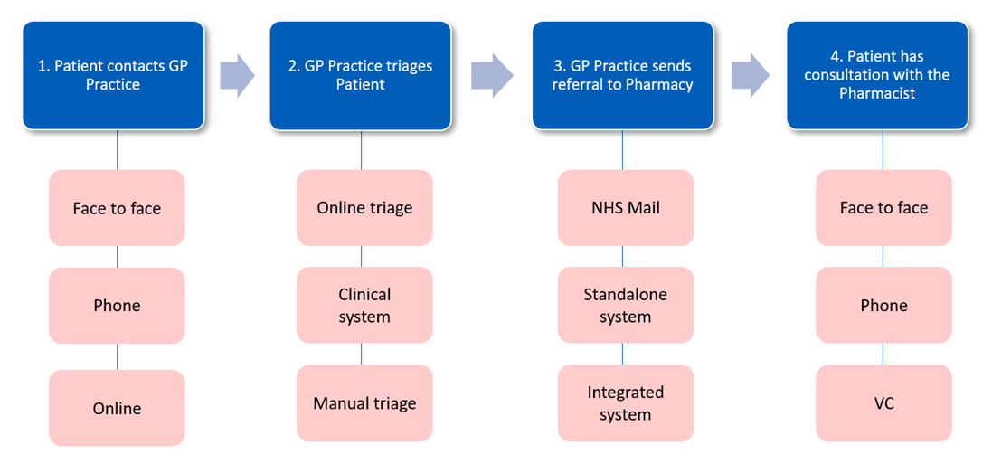
How do I refer patients to Pharmacy First?
You can refer patients to Pharmacy First whether they have contacted the practice by phone, online or in person.
Everyone in the practice who makes appointments for patients must know how to refer patients to Pharmacy First

Slide 10
How do I refer patients to Pharmacy First?
Where a patient is suitable for a minor illness referral or one of the seven common conditions:
Ask them which pharmacy they would like the referral to be sent to
Send a referral to the pharmacy using EMIS local services, PharmRefer or NHS mail. The referral contains information about why the patient is being referred, for the pharmacist to review ahead of or during the patient’s consultation.
When the referral is made, the patient initiates contact with the pharmacy. Please say something to the patient such as: ‘Please contact the pharmacy to discuss your treatment and advise that you have been referred by your practice. The telephone number and address are as follows’. To manage expectations, explain to the patient that they might not be seen immediately by the pharmacist at the pharmacy and may be asked to come back or make an appointment, this may or may not be the same day. Depending on the time of day the referral is made, the patient may not be seen on the same day.
Other phrases you may find useful when explaining the service to your patients:
‘Having listened to your symptoms, I am arranging a same day consultation for you with an NHS community pharmacist working with our practice.’
‘Pharmacists can now do more assessments and issue prescription only medications for particular conditions if needed’
‘You can telephone or visit the pharmacy to have a discussion with the pharmacist in their confidential consultation room. The pharmacist will ask questions about your health and your symptoms, including any allergies or any medications you’re currently taking. In some cases, based on your symptoms, they may need to do a quick examination such as if you have earache they may look in your ear with an otoscope.’
There are Community Pharmacy PCN Leads in some areas who can support practices in building up relationships with community pharmacies as well as helping with any queries you have. Please get in touch with your local pharmaceutical committee who will be able to put you in touch with them.

Slide 11
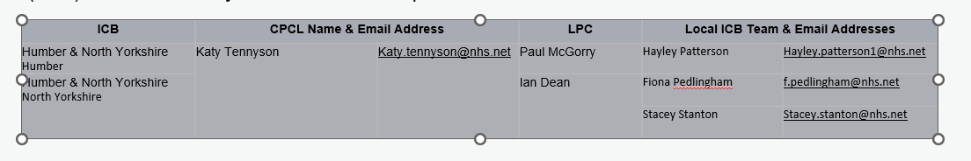
How do I know which pharmacies I can refer to?
More than 95% community pharmacies provide Pharmacy First.
You can use Service Finder which shows which pharmacies are providing pharmacy first. You will need to create an account to use this Sign in to your account - NHS Service Finder
If you have been sending GP referrals to CPCS then you will already know the details of your local pharmacies and if not, your Community Pharmacy Clinical Lead (CPCL), Local Pharmaceutical Committee (LPC) or Local ICB Team can help with this information
If you are using the integrated EMIS option or PharmRefer to send your referrals, then participating pharmacies are shown. This may be helpful if a patient wants to use a pharmacy further afield.

Slide 12



What happens next/what is the patient journey?
Prior to Referral
Patient contacts the Pharmacy
Patient contacts the Pharmacy
Minor Illness Referrals
7 clinical pathways
To manage expectations, explain to the patient that they might not be seen immediately by the pharmacist at the pharmacy, and they may be asked to come back or make an appointment, this may or may not be the same day.
Depending on the time of day the referral is made, the patient may not be seen on the same day.
Patient will have a 1-2-1 private consultation with the community pharmacist in the pharmacy consultation room or via a secure remote platform
The pharmacist will ask the patient questions about their health.
This may include their previous medical history, any allergies, any medicines they are taking and the symptoms they are currently experiencing.
For some conditions, the pharmacist may request to perform a quick examination, such as using an otoscope for patients presenting with acute otitis media symptoms.
For minor illness referrals, the patient outcomes can be:
advice;
advice and recommend self-care products; or (in a small percentage of cases)
onward referral by the community pharmacist back to the practice or to another setting such as an urgent treatment centre
If the referral is for one of the 7 clinical pathways, the patient outcomes also include the supply of certain prescription only medicines when appropriate e.g. antibiotics if needed

Slide 13


Can’t I just ask patients to ‘go to the pharmacy?
Many people visit community pharmacies every day for many different reasons such as to collect their prescriptions, to purchase medicines for self-care, for advice on health matters, for vaccinations, for other pharmacy services such as blood pressure checks or smoking cessation support.
GP practices should continue to digitally refer patients to Pharmacy First as per the former GPCPCS as opposed to signposting.
Patients will receive a confidential consultation. If signposted, may be treated as self-care support and possibly seen by another pharmacy team member.
Patients are reassured that their concern has been taken seriously and the pharmacist will be expecting them
If the patient does not contact the pharmacy, the pharmacist will follow up based upon clinical need.
Referrals enable the pharmacy to plan and manage workload, thereby meaning patients are seen in a timely manner.
Referral data can evidence that patients are actively being supported to access appropriate treatment, evidencing that GP practices are supporting the PCARP.
Clinical responsibility for that episode of patient care passes to the pharmacy until it is completed or referred on.
There is an audit trail of referral and clinical treatment, which will support onward patient care.

Slide 14
The Digital Elements
On 31 Jan 2024 when Pharmacy First starts:
Pharmacies will have new consultation templates for Pharmacy First from whichever of the 4 approved suppliers they contract with (PharmOutcomes, Sonar, Cegedim or Positive Solutions)
Practice teams should continue to electronically refer how they do now. For most EMIS practices that is by the integrated EMIS option and for most SystmOne practices it is by PharmRefer. Practices can send referrals by NHS mail, but it is more time consuming for both practices and pharmacies.
Information will be returned to practices from pharmacies in the same way it is now – from most pharmacies this is the post event message.

Slide 15
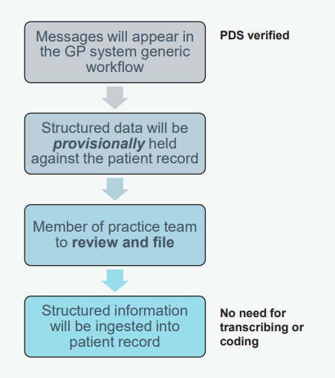
The Digital Elements (exact dates TBC):
GP Connect (Update Record) will be used to send a structured message of the consultation record and any medicines supplied back to the practice.
It is important that the structured message is ingested into the patient record at the practice so if the patient visits another setting for the same episode of care (the practice or another pharmacy) then previous actions and medicine supplies can be seen.
All structured messages will appear in the GP system generic workflow ‘for action’. Messages must be acknowledged/ actioned by GP staff after which information will be ingested into record without the need for transcription or coding.
As part of the improved digital connectivity between practices and pharmacies, community pharmacists will be able to view parts of the patient records via GP Connect (Access Record).

Slide 16
What about patient ‘bounce backs’ to the practice?
Data shows that 9 out of 10 patients have their episode of care completed by the community pharmacist,
  Pharmacists onward refer 1 out of 10 patients either back to the practice or to another setting such as an urgent treatment centre.
  This is for many reasons (such as red flags may have been identified or the patient may have deteriorated).
  This does not mean the service has failed – rather that it is working as expected.
The addition of the 7 clinical pathways with community pharmacists being able to supply specific prescription only medicines where clinically appropriate is expected to reduce the percentage of onward referrals.
Improving local relationships and agreeing local ways of working between practices and community pharmacists makes managing ‘bouncebacks’ better for practices, pharmacies and ultimately patients.

Slide 17
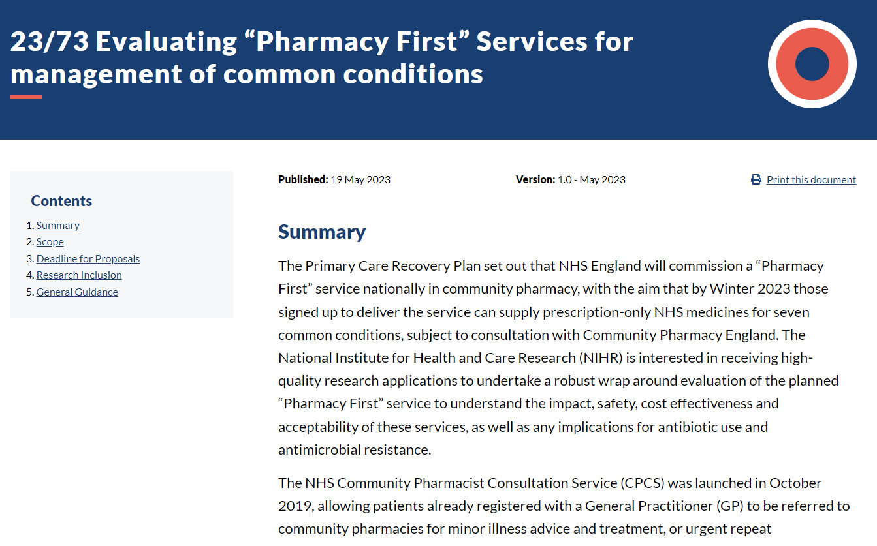
Surveillance

Slide 18
NHS Community Pharmacy Oral Contraception Service
This service enables community pharmacies to initiate and continue supplies of oral contraception.
Until 29 February 2024 some pharmacies may only be providing continuation of oral contraception. From 1 March 2024, all participating pharmacies will be initiating and continuing supply.
There is an NHS website postcode search tool to enable patients to find local pharmacies who deliver the contraception service.
Practices can refer people into this service or women can self-present at the pharmacy

Slide 19
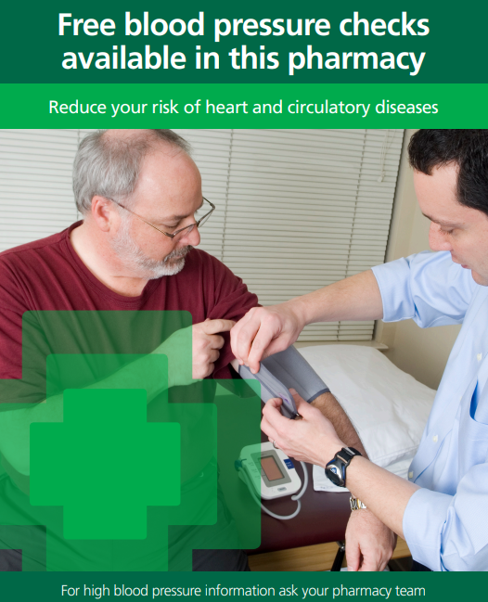
NHS Community Pharmacy Blood Pressure Check Service
Community pharmacy teams can offer people over the age of 40, without a diagnosis of hypertension, a BP check to find those with undiagnosed hypertension. In addition, they can also carry out BP checks at the request of practices.
Practices can ask pharmacies to complete clinic and ambulatory checks
It may be useful for practices who have patients on their hypertension registers without an up-to-date BP reading
It may be useful for practices with patients with a high initial reading who need ambulatory follow up
All readings will be returned to the practice for updating patient records
There is an NHS website postcode search tool to enable patients to find local pharmacies who deliver the Blood Pressure Check Service.
General practices can refer patients to community pharmacies for both clinic and ambulatory measurements

Slide 20
Next steps
A national toolkit for general practices and PCNs containing lots of helpful, more detailed information about the Pharmacy First service is in development. Link to be shared once published
Further useful information, including the Pharmacy First Service Specification, clinical pathways, and PGDs can be found here: NHS England » Community Pharmacy advanced service specification: NHS Pharmacy First Service
Please talk to your local community pharmacists about the Pharmacy First service
Local community pharmacists, the Community Pharmacy Clinical Leads in the ICBs, the LPC and Local ICB team are working together to support delivery of Pharmacy First. They may be contacting you to offer local support and to put you in touch with local community pharmacists who you may already be working with
You might find it helpful to print off slides 4, 5 and 6 which show the conditions that can be electronically referred to community pharmacies.
For more information on any of the PCARP pharmacy services (Pharmacy First, Blood Pressure Checks and Oral Contraception) please contact your Community Pharmacy Clinical Lead (details on slide 11).

