Slide 1
Treatment of Myocardial Infarctions
Emily Waterman
Directorate pharmacist for critical care and cardiology

Slide 2
Introduction
Types of MI and how they are treated
Common medications
Antiplatelets
Betablockers
ACE inhibitors and ARBs
Statins
GTN
Others
The future?

Slide 3
What is a Myocardial Infarction?
A myocardial infarction (MI) literally means ‘heart muscle death’
It is almost always caused by coronary heart disease
Other causes include Type II MI
The heart muscle is starved of oxygen leading to muscle damage and/or death

Slide 4
Coronary Heart Disease
The inside of coronary arteries becomes narrowed due to fatty deposits (atheroma) in the artery walls – this is called a plaque
If the plaque cracks or breaks, platelets form a blood clot to ‘heal’ the damaged vessel
This blocks the artery leading to the heart muscle being starved of oxygen
Notes:
Diagram from BHF information booklet
Photos from www.thecardiologist.co.uk
The cause of a heart attack is nearly always coronary
heart disease. This is a condition where the inside of
one or more of the coronary arteries becomes narrowed
because fatty deposits called atheroma have built up
within the artery walls. The fatty area of atheroma in the
artery wall is called a plaque.
If a plaque cracks, a blood clot forms to try to repair the
damaged artery wall. This blood clot can totally block
your coronary artery, causing part of your heart muscle
to be starved of blood. If this happens, the affected part
of your heart muscle will begin to die, because it is not
getting oxygen. This is a heart attack.
During a heart attack there is also the risk of having a
cardiac arrest. This is when the heart stops pumping
blood and normal breathing stops. We explain more
about this on page 12.

Slide 5
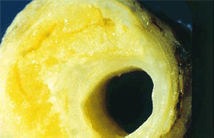
Coronary artery plaque
Blood clot in a coronary vessel

Slide 6
Acute Coronary Syndrome (ACS)
A collective term used to describe conditions where blood supply to the heart muscle is impeded, it includes
ST Elevated Myocardial Infarction (STEMI)
Non-ST Elevated Myocardial Infarction (NSTEMI)
Unstable angina
Differentiated by ST changes on ECG and troponin result
This talk will focus on STEMI and NSTEMI
Notes:
STEMI – ST changes on ECG (and troponin rise) – and complete blockage of artery
NSTEMI – no ST changes on ECG and troponin rise – partial blockage of artery
Unstable Angina – no ST changes on ECG and no troponin rise

Slide 7
ACS Treatment for York Patients
STEMI
Transferred to Leeds General Infirmary for primary PCI
NSTEMI
Admitted to York hospital for monitoring and treatment with angio +/- stents

Slide 8
Coronary Angiogram/Angioplasty
Used in almost all cases of MI
Involves injecting contrast dye to visualise coronary arteries and identify any blockages
If appropriate stents deployed to widen arteries

Slide 9
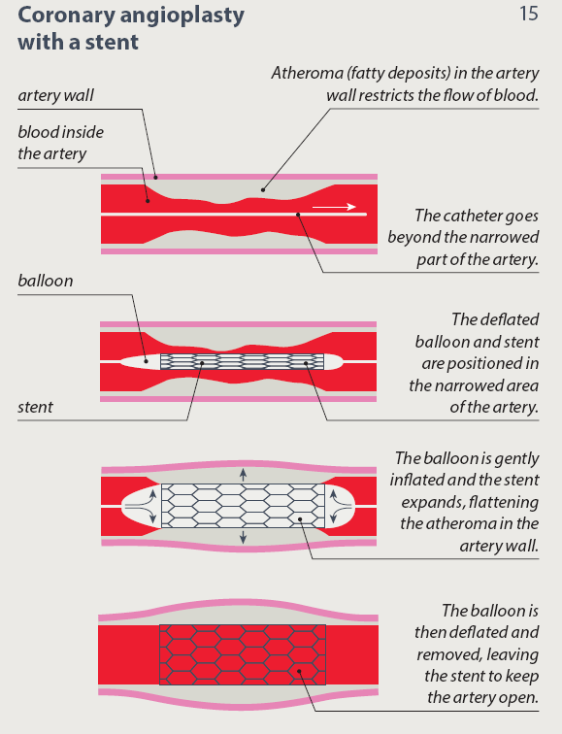

Slide 10
Post MI Secondary Prevention
Cardiac rehabilitation
Series of sessions covering exercise, stress management, pharmacy talk, health education
Lifestyle
Mediterranean diet, smoking cessation, physical activity
Drug therapy
See NICE Clinical Guideline 172 for full details
Notes:
Primary prevention – at high risk of having MI
Secondary prevention – for patient’s who have had an MI

Slide 11
Post MI Secondary Prevention Medication
Discussed in brief by cardiac rehabilitation nurse prior to discharge from hospital
For patients attending cardiac rehab sessions we provide a pharmacy session for the most common medications
Aim to be educational, informative and practical
And now follow up by community pharmacist to provide patient specific advice
Patients can never be given too much information and education?!?!

Slide 12
Post MI Secondary Prevention Medication
Antiplatelets
ACE Inhibitors and angiotensin II receptor blockers
Betablockers
Statins
GTN spray
Other medication

Slide 13
Advice we give patients post MI

Slide 14
Antiplatelets
Aspirin plus another antiplatelet for a set period of time = dual antiplatelet therapy (sometimes abbreviated to DAPT)
Use ticagrelor as standard but can also use clopidogrel or prasugrel

Slide 15
Aspirin
One of the components of the blood that form blood clots are called platelets
Aspirin works to make the platelets less ‘sticky’ so less likely to form a clot where we don’t want there to be one i.e. in coronary artery
Taken life long unless told otherwise

Slide 16
Aspirin
Take with food to reduce GI side effects
If prone to GI upset or significant past medical history then can be prescribed PPI or ranitidine
Avoid any aspirin or ibuprofen containing medication OTC
Advise to seek advice from pharmacist before buying any medication
May note bleed/bruise more easily, seek medical advice if severe or unusual
Notes:
Men shaving

Slide 17
Ticagrelor, Clopidogrel and Prasugrel
Usually used for 12 months DAPT but may be less
Reduce the chance of cardiovascular death and further MI
Choice of second antiplatelet depends on patients condition being treatment and other factors
Ticagrelor most widely used in this area
Twice a day dose as close to 12 hourly as practically possible

Slide 18
ACE Inhibitors (and ARB)
Most commonly used in York is ramipril
Used to reduce blood pressure and improve condition of the heart over time
Started low and titrated up
Monitor kidney function after dose change and regularly throughout treatment

Slide 19
ACE and ARB
Dry cough
Common side effect is dizzyness due to lowered blood pressure
Reduce by taking at night or taking a split dose, e.g 2.5mg BD instead of 5mg OD
Sick day rules
Omit if suffering from diarrhoea and vomiting (increased risk of AKI)

Slide 20
Betablockers
Most commonly used in York is bisoprolol
Used to control the rate the heart beats at to stop it beating too fast, reduce blood pressure and reduce the amount of work the heart has to do
Dose is started low and gradually increased as tolerated
Usually advise to take in the morning due to sleep disturbance but can take at night

Slide 21
Betablockers
Common side effects due to hypotension
May notice heart takes a bit longer to ‘kick in’ when start exercise
Not for patients with asthma
Caution in patients with diabetes as can mask symptoms of hypoglycaemia
Numbness and tingling in fingers and toes
Not to stop suddenly

Slide 22
Statins
Post MI should be prescribed atorvastatin 80mg daily
Used to reduce cholesterol levels and stabilise any plaques that already exist
Taken at night as liver enzymes more active at night however if forgetting to take most nights then take in the morning

Slide 23
Statins
Myalgia, general muscle aches and pain can be usually be managed by switching statin or reducing dose and building up
Many patients labelled statin intolerant too quickly
Rhabdomyolysis much more rare but serious
Affects big muscle groups on both sides of the body and pain occurs at rest

Slide 24
GTN Spray
Used for acute chest pain and given to almost all patients post-MI
Exceptions include aortic stenosis, CAGB
Dilates/widens arteries to make it easier for blood to flow to heart
Sit down, use 1 or 2 sprays under tongue
Will also be absorbed from cheek or other oral mucosa if cannot spray under tongue
Repeat if needed if pain recurs or isn’t completely resolved
If need to use 3rd time then dial 999 and come to hospital

Slide 25
GTN Spray
Can have more than one spray
If keeping in the car, keep in glove box away from direct sunlight and high temperatures
Have a reminder to check expiry twice a year
If notice an increase in the frequency of needing to use spray then see GP

Slide 26
Diltiazem
Sometimes used in patients who cannot have a betablocker, for example PMH of asthma
Stick to same brand
If you notice discrepancy between modified release formulation and dosing frequency please question it, for example Adizem SR prescribed once a day

Slide 27
Anticoagulants
Occasionally anticoagulant therapy is indicated post MI
Anticoagulant and dual antiplatelet therapy is referred to as ‘triple’ therapy
Can be with warfarin or NOAC
NEVER use ticagrelor in triple therapy
Notes:
e.g. anterior STEMI, mural thrombus, AF

Slide 28
Miscellaneous/General
Advice on missed doses
Tips on how to remember to take medicines and fit them into usual daily routine
Buy OTC medication from a pharmacy
Follow government guidelines for alcohol consumption
Follow diet and lifestyle advice
Smoking cessation
Be wary of newspaper articles!

Slide 29
FAQ from patients
Can I take them all at the same time in one handful?
Why DAPT for one year only?
Changing colour/brand of tablets
Herbal remedies and supplements

Slide 30
Finding out more information
British Heart Foundation website
Information for health care professionals
Can download patient information booklets
NICE (www.nice.org.uk)
Chest pain of recent onset (CG95)
STEMI: Acute management (CG167)
Unstable angina and NSTEMI: Early management (CG94)
Myocardial infarction: Cardiac rehabilitation and prevention of further MI (CG172)
SIGN (www.sign.ac.uk
Acute coronary syndrome (Guideline 148)

Slide 31
The Future?
PSK 9 Inhibitors
Alirocumab (Praluent) and evolocuman (Repatha)
NICE draft guidelines published May 2016 recommend these drugs for adults with hypercholesterolaemia or mixed dyslipidaemia to help reduce risk of cardiovascular disease
For patients whose cholesterol is not adequately controlled with other drugs or cannot tolerate medication, e.g. statins
Given by subcutaneous injection every 2 weeks
Ticagrelor 60mg BD
For high risk patients who have had an MI
90mg BD for 12 months and then 60mg BD for up to 3 years
Has been submitted to NICE for approval

Slide 32
Other Cardiology News
Sacubitril/valsartan (Entresto) for heart failure
Patients should NOT be prescribed ACE or ARB while on sacubitril/valsartan
Need a mimimum 36 hour wash out period when changing to or from ACE inhibitor and sacubitril/valsartan

